Slide 1
OSTEOARTHRITIS OF KNEE JOINT

Slide 2
Reumatology denotes the branch of medicine which deals with the medical disorders of the musculoskelital or locomotor system . French physcian Guillaume de Baillou,known as the father of Rheumatology,who introduced the term rheumatism for joint ailments.

Slide 3
OSTEOARTHRITIS

Slide 4
KNEE JOINT
Also called as tibio femoral joint.it is formed by the
-medial and lateral condyles of distal end of femar.
- medial and lateral condyles of tibia.
- between the condyles ,inter condylar fossa provides space for the anterior crusiate ligament and posterior crusiate ligament.

Slide 5
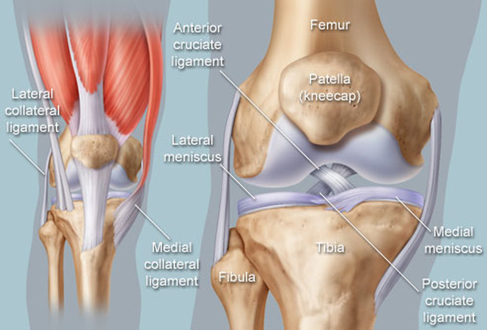
KNEE JOINT

Slide 6
Knee joint is a synovial hinge joint,formed between 3 bones ,FEMAR,TIBIA,and PATELLA.
Which allows flexion ,extension,and small degree of medial and lateral rotation.

Slide 7
OSTEOARTHRITIS
Most common form of arthritis,disease of elderly.
Major risk factors
- Age
- obesity
- previous joint trauma
- occupations causing excessive bending or overstrain of joints.

Slide 8
PATHOPHYSIOLOGY OF OA KNEE
Pathophysiologic changes occurs in,
Articular cartilages
Synovial fluid
Underlying bone
Joint capsule

Slide 9
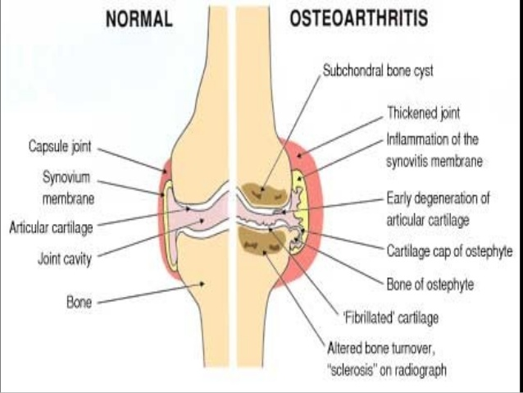

Slide 10
Changes In Articular Cartilage
Malfunctioning of chondrocytes
Cartilage become dehydrated and brittle.
Formation of cracks and fissures.
Loss of cartilage
Reduction of joint space

Slide 11
OSTEOARTHRITIS
Characterised by
Focal loss of articular cartilage
Subcondral osteosclerosis
Osteophyte formation at joint margin
Remodelling of joint contour with enlargement of affected joints.

Slide 14
What causes the chondocytes to stop functioning????

Slide 18
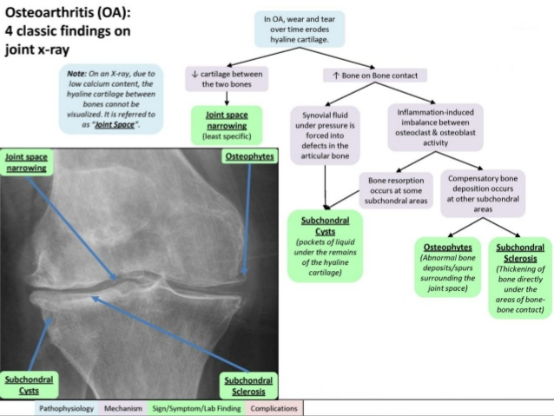

Slide 20
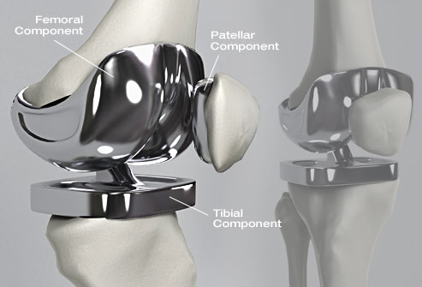
KNEE JOINT REPLACEMENT

